Slide 1


Mid Year Clear
Brooklyn Infocommons
July 17, 2021
Exp 01/21
777ggf

Slide 2

Overview
Intro
Special Guest- Matt Mitchell
Mid Year Clear
Outro

Slide 3
Who Are we?
We are…
The Cypurr Collective: A group of folks that organize cybersecurity events, looking to spread knowledge and talk about privacy rights!
Established April 2016
Just some folks interested in making safer spaces for others to talk bout their privacy needs

Slide 4

A Few Rules for the Space
Saf(er) Space - We DO NOT tolerate language or behavior purposefully meant to demean or harm folks based on their identities
Feel free to ask questions!

Slide 5
A Few Rules for the Space
Slides/Resources available after! Video available soon.
A note on voice recording…
We are trying to keep these presentations for posterity, and not to record participants. We will try to anonymize people when possible but please be aware that we are recording and may need to keep voices in the audio for context. Use the chat if possible for questions and discussions if you do not want your voice on the recording.

Slide 6
And now…

Slide 7
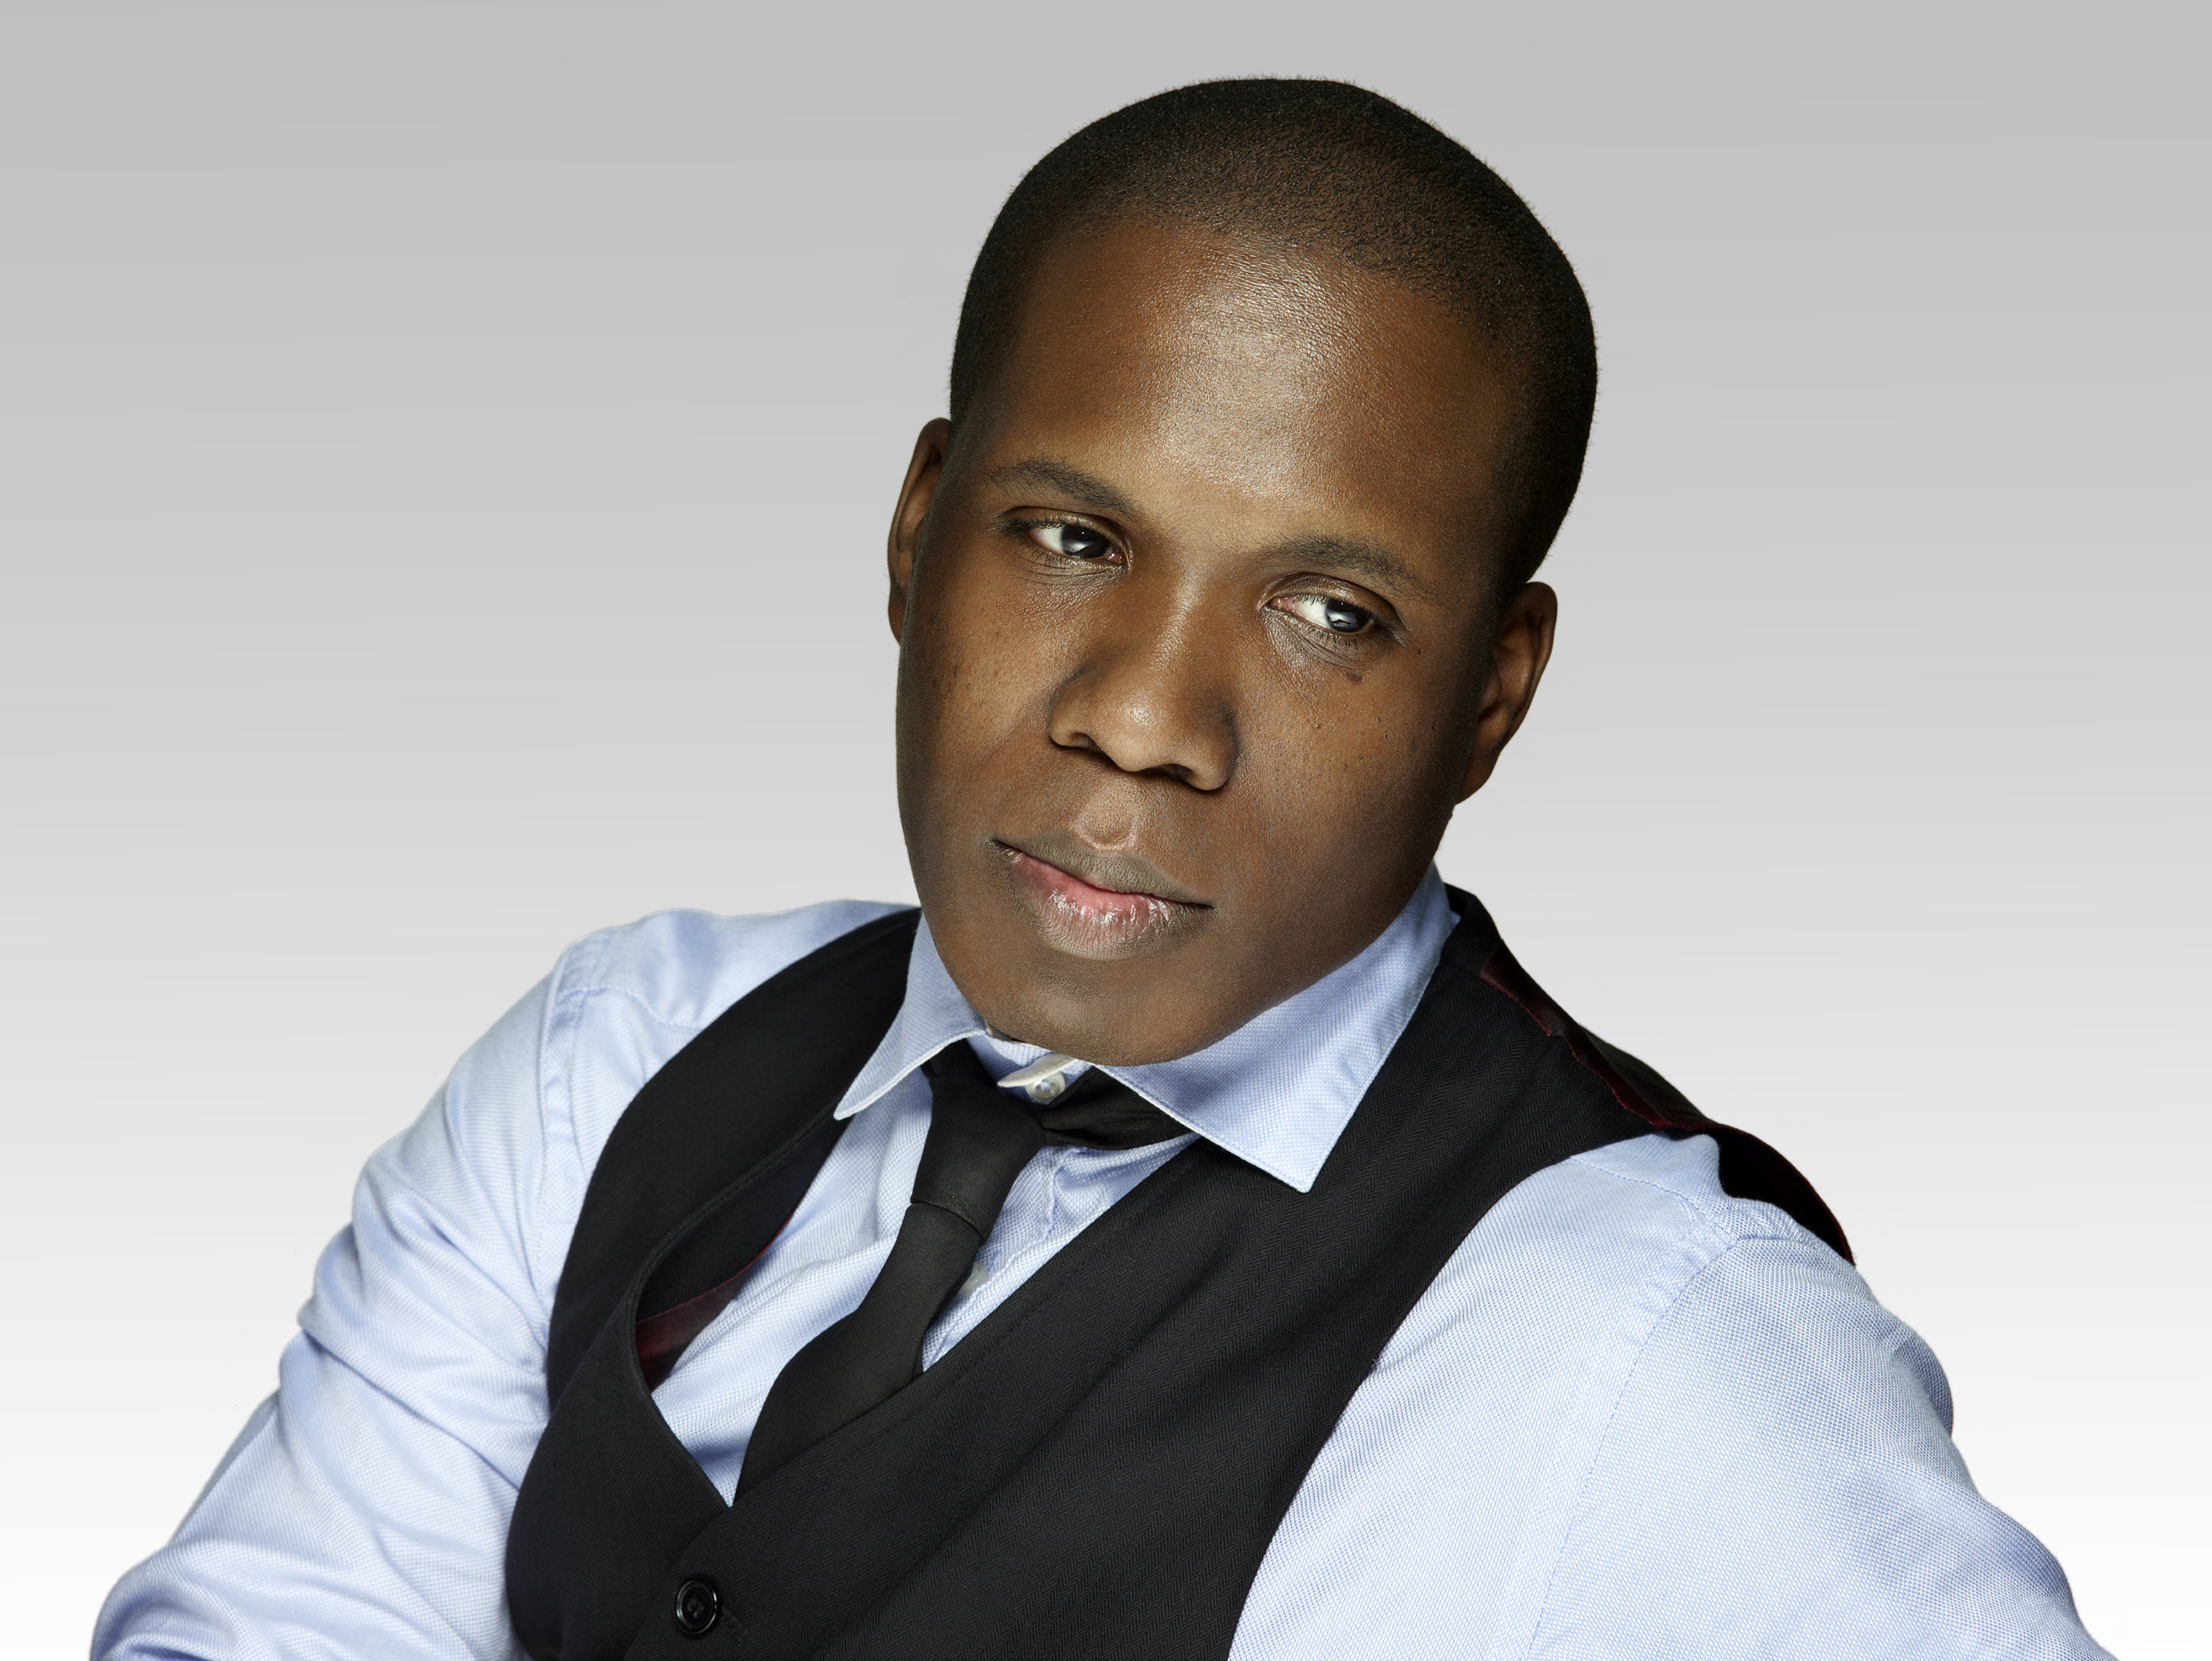
Matt Mitchell
Matt Mitchell is a hacker, founder of CryptoHarlem, and tech fellow to the BUILD program at the Ford Foundation. In his work there Matt develops cybersecurity strategy for the foundation's grantee partners.
Matt is a well known security researcher, operational security trainer, and data journalist who founded & leads CryptoHarlem ( https://twitter.com/cryptoHarlem ), impromptu workshops teaching basic cryptography tools to the predominately African American community in upper Manhattan.
(Photo Credit: Nick Lee)

Slide 8


Slide 9
Data Detox?

Slide 10

Data Detox
What is it?
Tactical Tech/Mozilla
The process of raising self awareness of
your use of the digital world
how you interact with it
who you interact with
what info you put out there
the value of that info
how to better control the flow of data going toward and away from you

Slide 11

A Story of You
You and your Data

Slide 12

A Story of You
You and your Data
Who- Who are you? Who you know? Who are you connected to? Who you think you are? Who others think you are?
What- What do you do? What do you like? What are your hobbies? What do you do for your free time?
When- When were you born? What generation are you? When do you wake up? When do you go to work? When do you go online?
Where- Where do you live? Where do you work? Where do you exercise? Where do you shop? Where do you search?
How- How do you communicate? How do you make decisions? How do you learn? How do you shop?

Slide 13

Data Detox
What is it?
Not a perfect endeavor, but a worthwhile one
Understanding digital footprint
Data and consent
Understanding limits and capacities

Slide 14
Data
Awareness
(Today)

Slide 15
Data
Awareness
(Today)
Prevention
(Part 2 coming July 2021)

Slide 16

Some tips…

Slide 17

Scrutinize
Free Isn’t Free
Privacy Policy/Terms of Use- Does the company respect your privacy?
Ethics of Company- Are they profiteers or are they concerned about their users?
Open Source- Is the code open for audit? Is there transparency?

Slide 18
Scrutinize
Privacy Policy/Terms of Use
Does the company respect your privacy?
Free Isn’t Free
What is Collected
Information you provide
Usage
Device Information
How it’s Stored
Encrypted?
Access?
When accessed?
How it’s Shared
Does it get sold?
To whom?
How are these entities vetted?

Slide 19

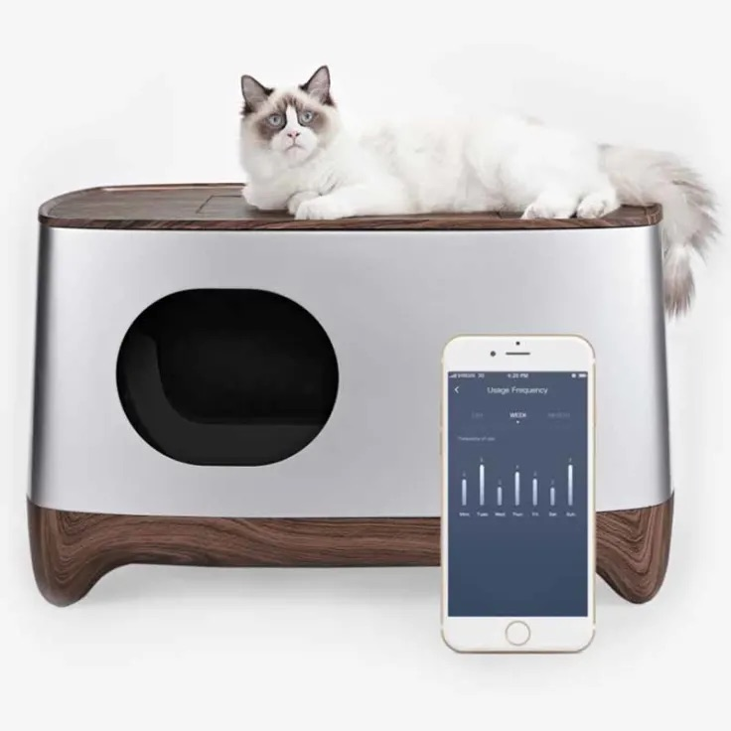
Scrutinize
Free Isn’t Free
Ethics of Company- Are they profiteers or are they concerned about their users?
*privacy not included (Mozilla)
Ikuddle Auto Pack Litter Box
No Privacy Policy
Will you receive it?

Slide 20

Scrutinize
Free Isn’t Free
Open Source- Is the code open for audit? Is there transparency?

Slide 21

Alternatives
Pros
Lists privacy-minded apps
Cons
Convenience

Slide 22
Common Digital Interfaces

Slide 23
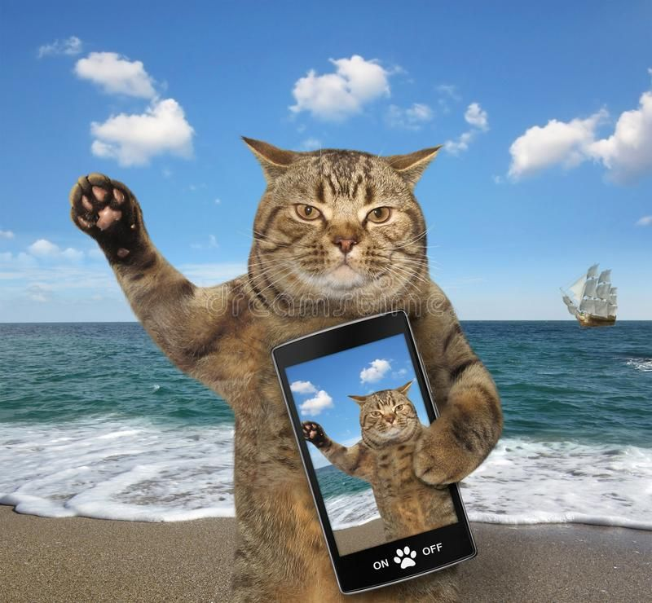
Phones
Tidying Up

Slide 24
Phones
Tidying Up
Do you need all that app clutter?- What apps am I using? What apps take up space?

Slide 25
Phones
Tidying Up
Do you need all that app clutter?- What apps am I using? What apps take up space?
Does your phone give you away?- Do you use your name for your phone/wifi/bluetooth?

Slide 26
Phones
Tidying Up
Do you need all that app clutter?- What apps am I using? What apps take up space?
Does your phone give you away?- Do you use your name for your phone/wifi/bluetooth?
What services run in the background?- Do you NEED wifi/bluetooth on all the time?

Slide 27
Phones
Tidying Up
Do you need all that app clutter?- What apps am I using? What apps take up space?
Does your phone give you away?- Do you use your name for your phone/wifi/bluetooth?
What services run in the background?- Do you NEED wifi/bluetooth on all the time?
Start from Scratch?- Factory Reset?

Slide 28
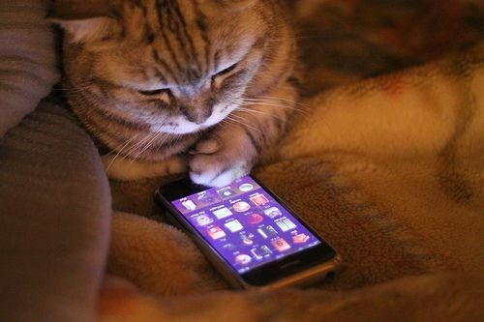
Apps
Tidying Up
Permissions- What are you allowing the app to access?
Location
Photos
Contacts
Camera
Keyboard
Media

Slide 29
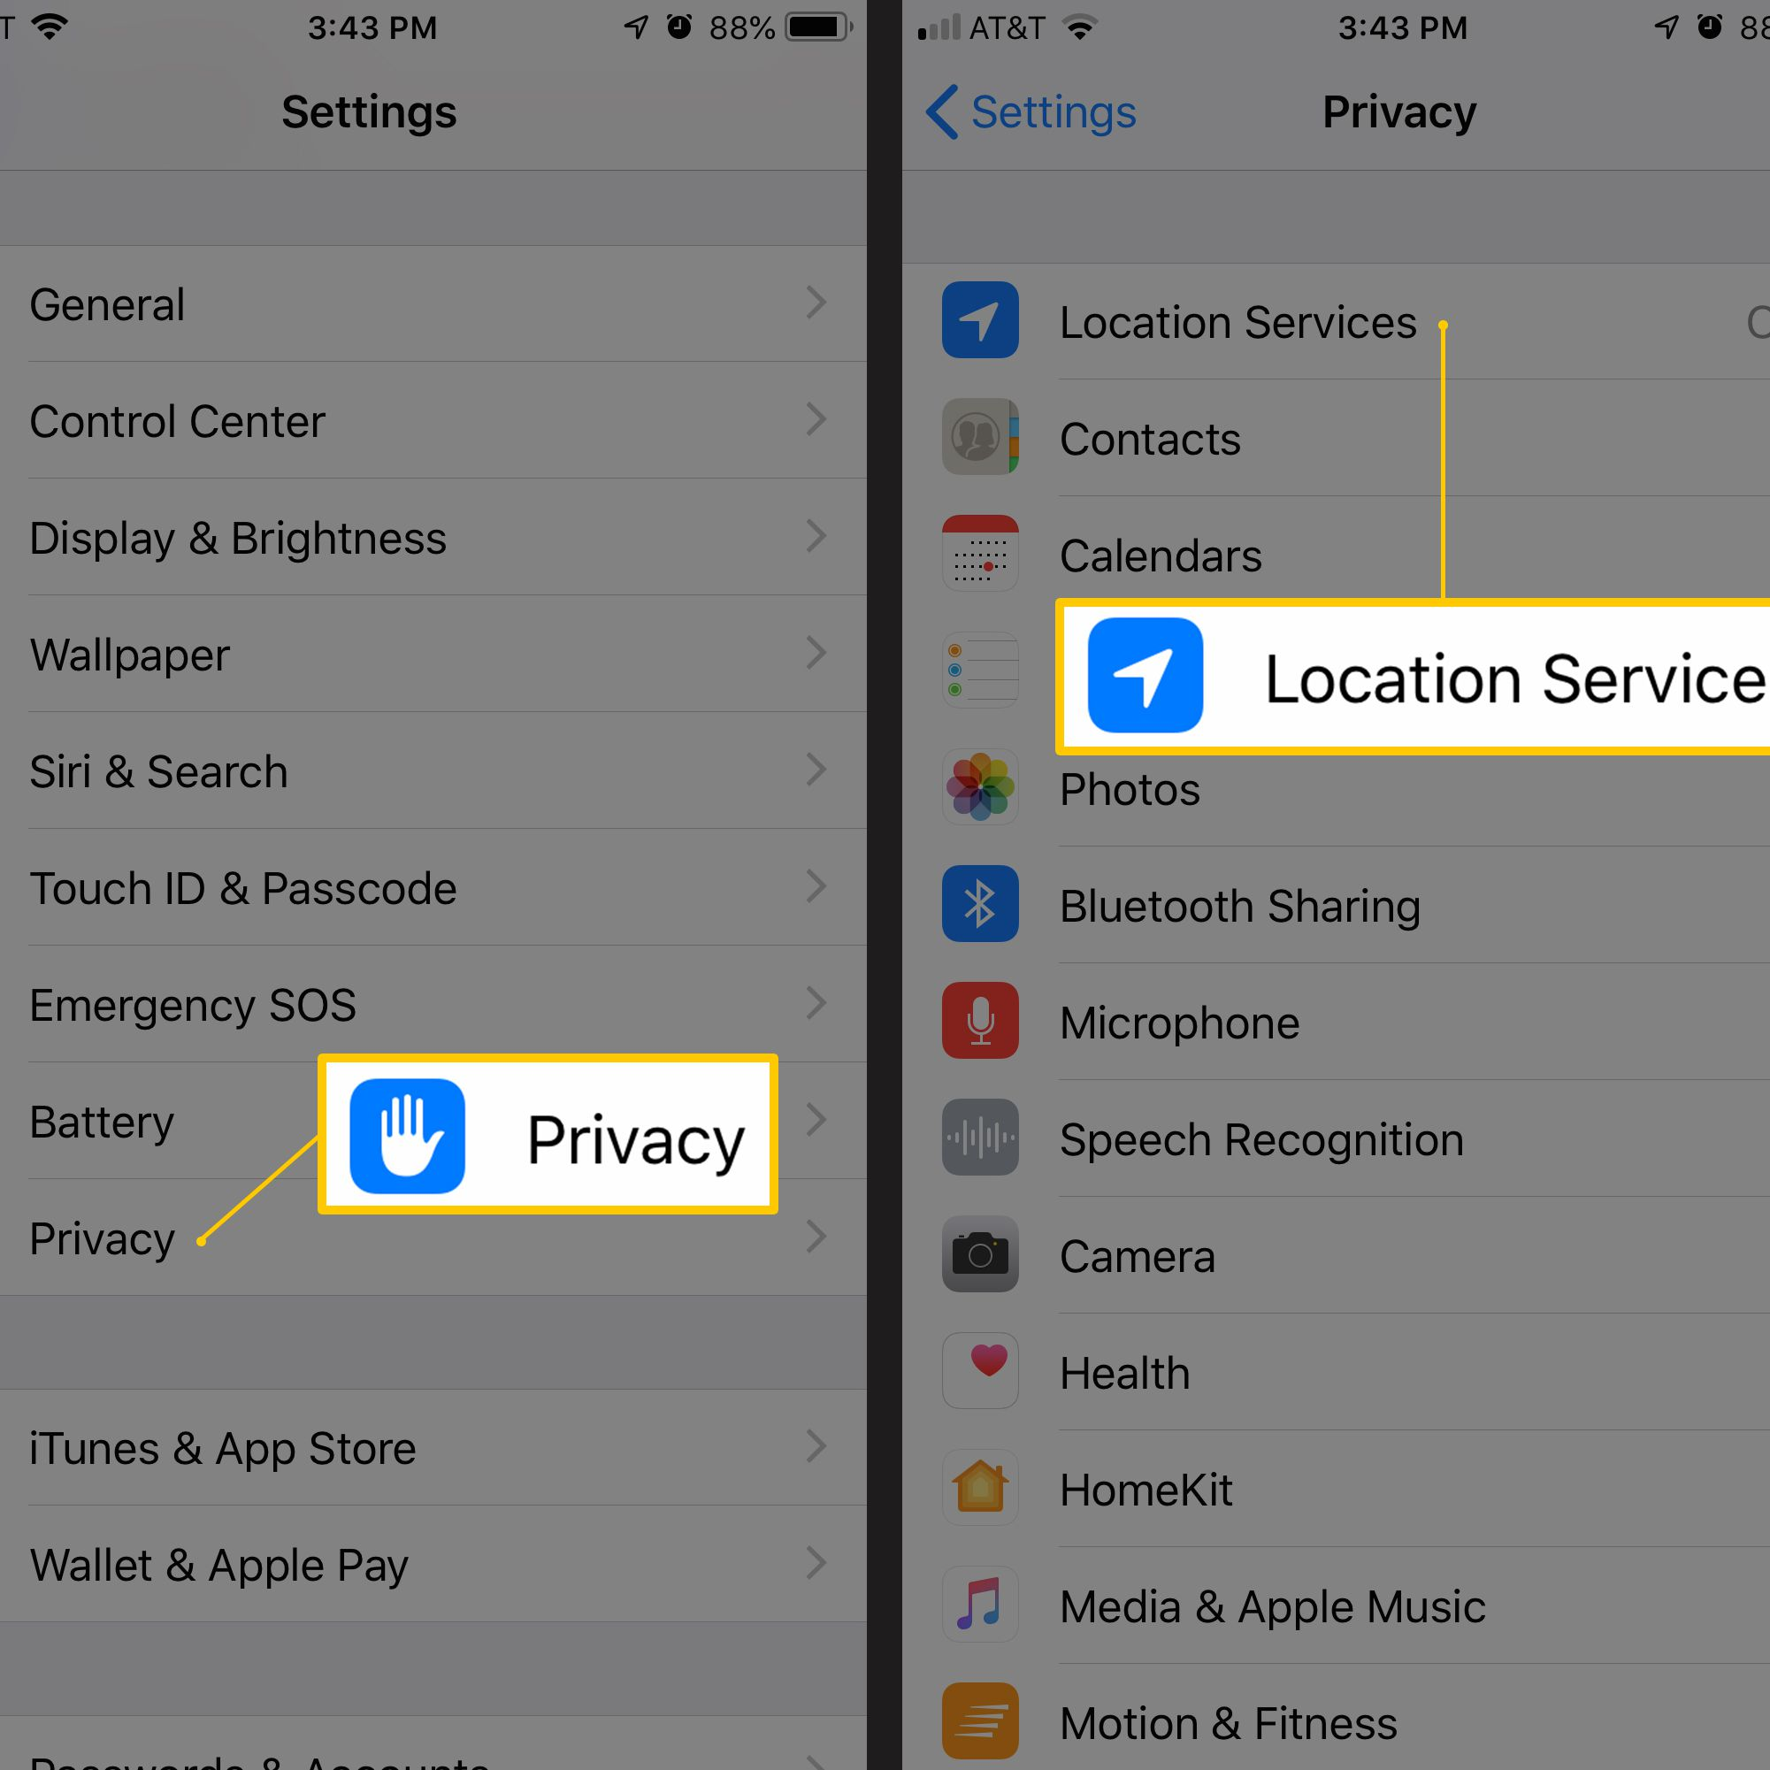
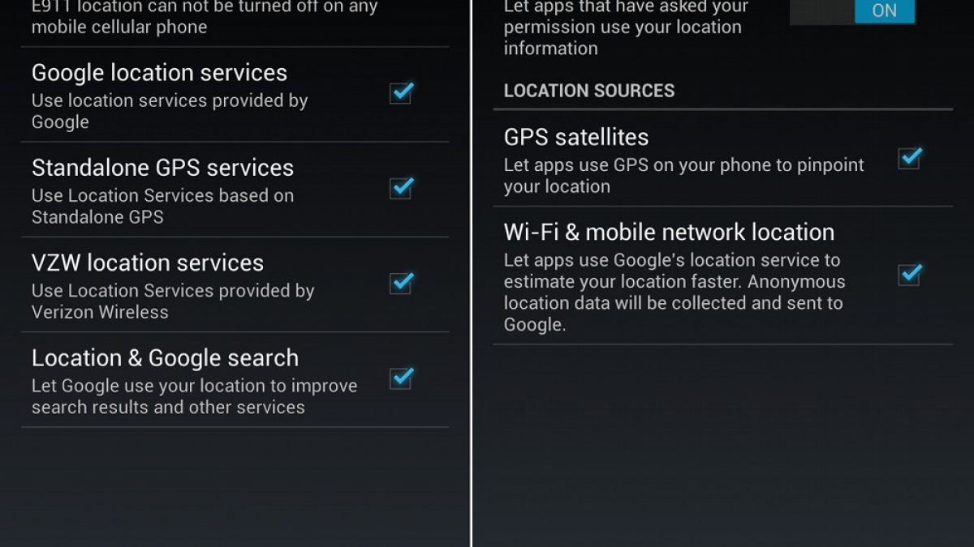
Location
Is the app actively keeping track of you?

Slide 30
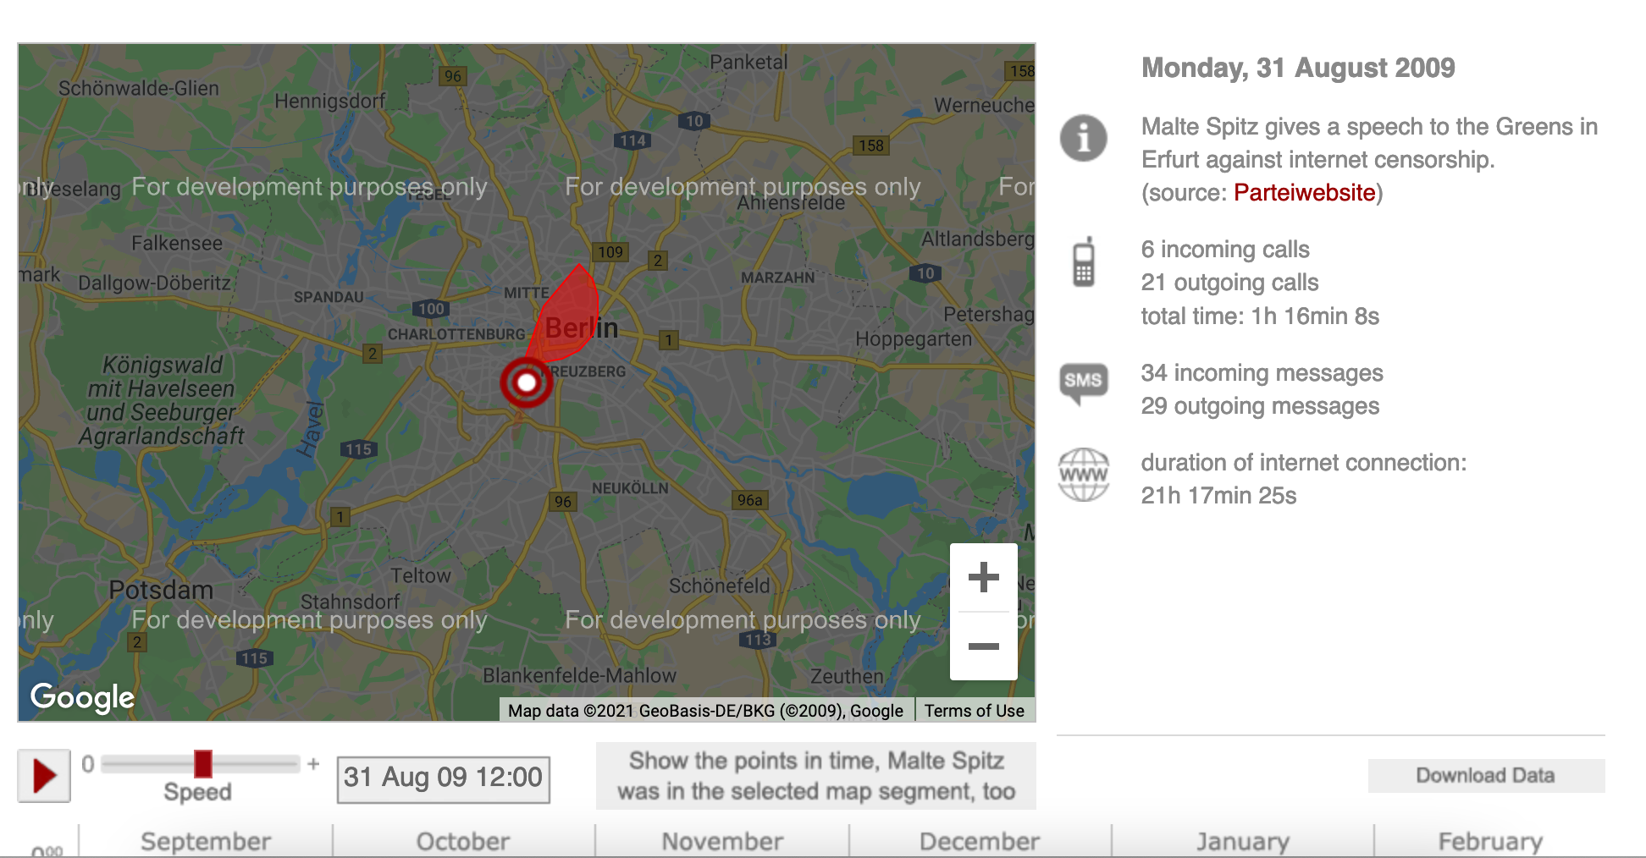
Green party politician Malte Spitz sued to have German telecoms giant Deutsche Telekom hand over six months of his phone data that he then made available to ZEIT ONLINE. We combined this geolocation data with information relating to his life as a politician, such as Twitter feeds, blog entries and websites, all of which is all freely available on the internet.
By pushing the play button, you will set off on a trip through Malte Spitz's life. The speed controller allows you to adjust how fast you travel, the pause button will let you stop at interesting points. In addition, a calendar at the bottom shows when he was in a particular location and can be used to jump to a specific time period. Each column corresponds to one day.

Slide 31
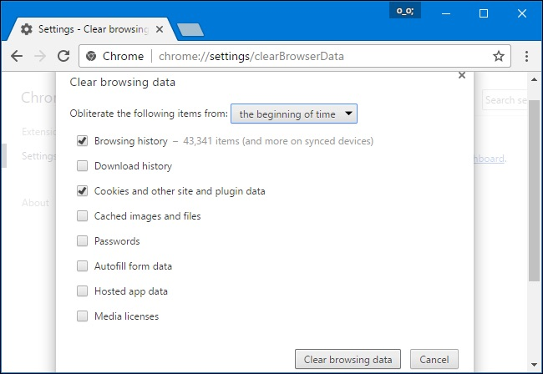
Browsers
Too many cookies
History/Cache/Cookies- What does your browser say about you?

Slide 32
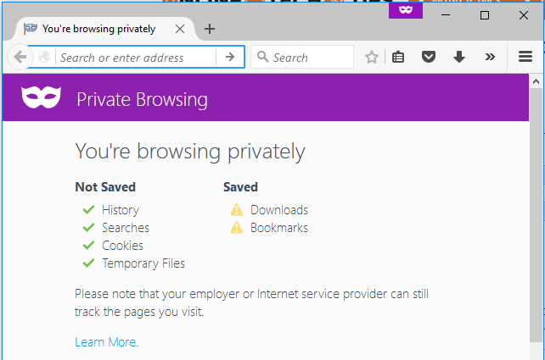
Browsers
Too many cookies
History/Cache/Cookies- What does your browser say about you?
Privacy Mode
Ex.
Incognito Mode (Chrome)
Privacy Mode (Firefox)

Slide 33

Social Media
ooph….

Slide 34
Social Media
ooph….
Settings- Does everyone need to know you like that? What privacy options does the company offer?

Slide 35
Social Media
ooph….
Settings- Does everyone need to know you like that? What privacy options does the company offer?
RSVP?- Do you NEED to RSVP to events?

Slide 36
Social Media
ooph….
Settings- Does everyone need to know you like that? What privacy options does the company offer?
RSVP?- Do you NEED to RSVP to events?
Tags- Do you NEED to be tagged?

Slide 37
Social Media
ooph….
Settings- Does everyone need to know you like that? What privacy options does the company offer?
RSVP?- Do you NEED to RSVP to events?
Tags- Do you NEED to be tagged?
Past Posts- Do you NEED all your posts?

Slide 38
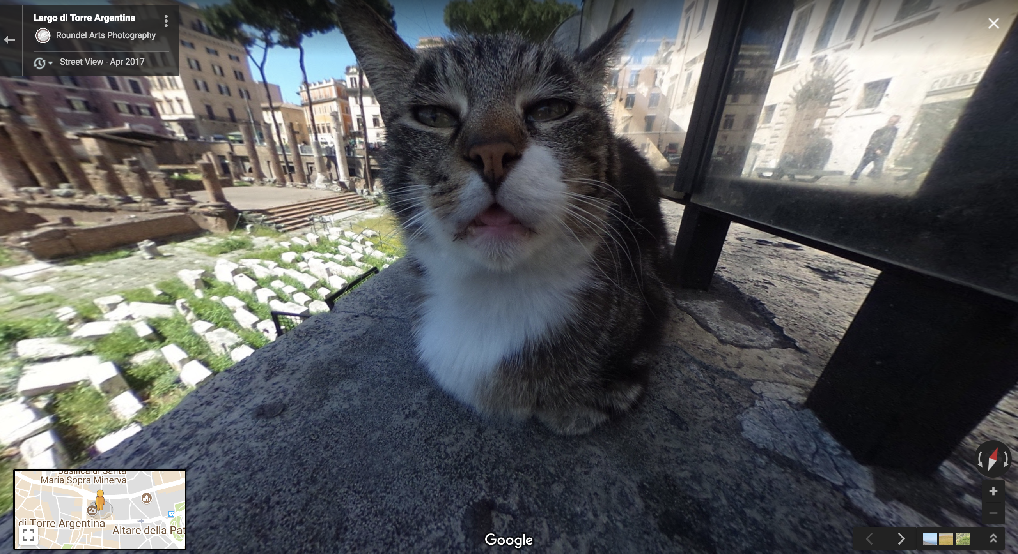
Online Search
What’s out there…?
Google yourself!

Slide 39
Online Search
What’s out there…?
Google yourself!
Internally-
Location Information
Searches

Slide 40
Online Search
What’s out there…?
Google yourself!
Internally-
Location Information
Searches
Externally
Old Profiles?
Images
People Finder?

Slide 41
Online Search
What’s out there…?
Google yourself!
Internally-
Location Information
Searches
Externally
Old Profiles?
Images
People Finder?
Resource Tip:
Check out Privacy Duck!

Slide 42
Detox Summary
Your data is valuable (probably because you’re valuable)
Threat Model to take inventory- you know your needs and situation best!
App Consciousness- think about WHY you need an app, think about what the app needs from you
Digital Hygiene- No worries if you make mistakes, the best strategy is to do this frequently

Slide 43
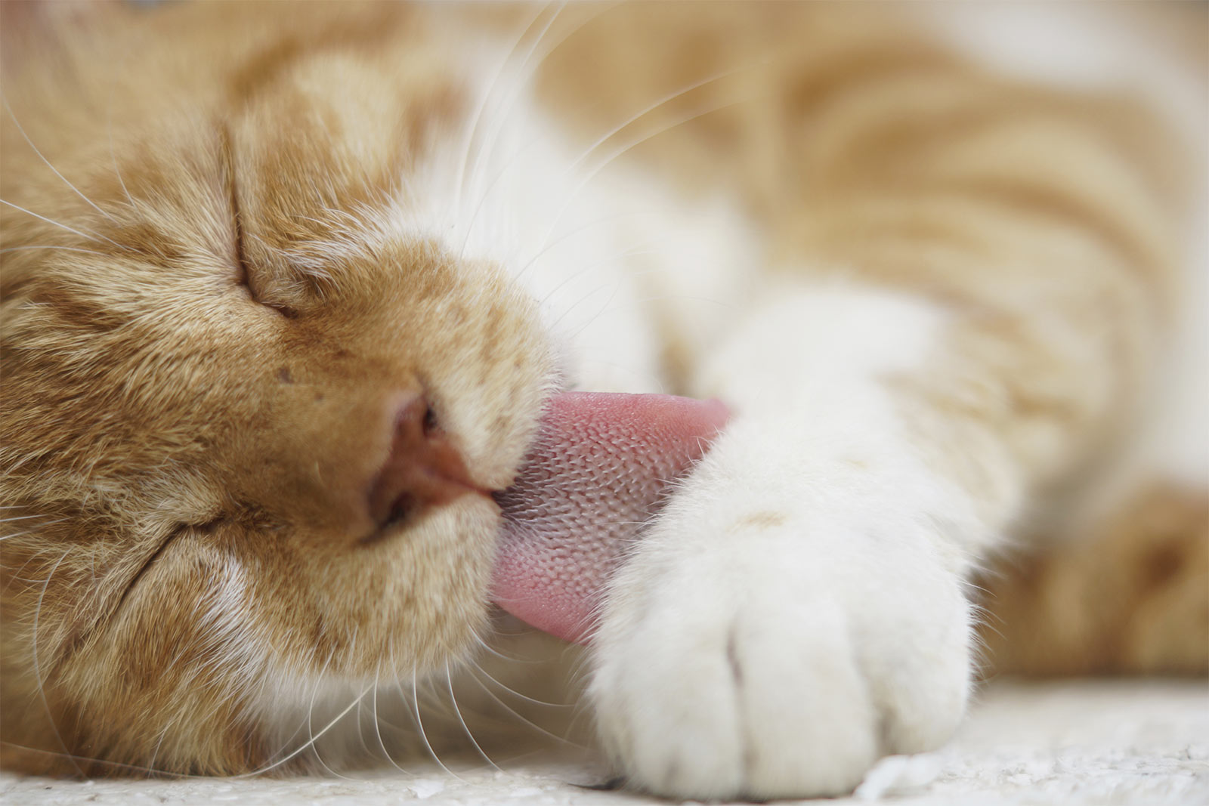
GO FORTH AND DETOX!
Thanks for watching!

Slide 44

Further Resources
Cypurr Resources
Website- https://cypurr.nyc
Open Collective (Donation/Tshirt)- https://opencollective.com/cypurr-collective
Questions? Comments? Topic Ideas?
Email- cypurr@protonmail.com
Join our email list for updates!
Social Media- FB/Twtitter @cypurrnyc

